Slide 1


Haze-Fog Suppression
University progect in collaboration with FlySight

Slide 2
INTRODUCTION
01
PIX2PIXHD
02
MODELS
DATASET
CONTENTS
04
03
EVALUATION
05
CONCLUSIONS
06
Short introduction to the problem
NVIDIA models to image translation
Generation of GAN model and classifier
Synthetic dataset generation
Test of models with metrics
Final consideration

Slide 3
01
Introduciton

Slide 4
INTRODUCTION
Atmospheric haze is a pervasive challenge that hampers visibility, impacting both human perception and machine vision systems. In scenarios where haze is prevalent, scenes lose clarity, affecting object recognition and even essential activities such as safe driving.
In this article, we embark on a journey to combat this issue. We begin by delving into the mathematical foundations of Image Hazing, including the use of atmospheric scattering models to create synthetic haze images.
To face with this issue, we choose to use GAN models and convolutional neural networks that offer us a promising solution to mitigate the effects of haze in various real-world scenarios.

Slide 5
02
Pix2PixHD

Slide 6
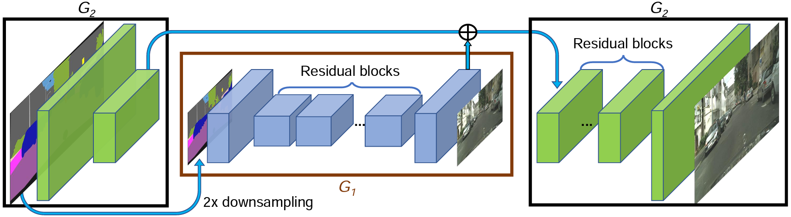
Pix2PixHD
The main innovations include:
1. Coarse-to-Fine Generators: The Pix2PixHD approach divides the generator into two networks, G1 and G2. G1 operates globally at a lower resolution, while G2 acts as a local enhancer, producing higher-resolution images. This design allows for the generation of high-quality images at resolutions up to 4096×2048.
2. Multi-Scaled Discriminators: To distinguish real images from generated ones, three discriminators (D1, D2, D3) that operate at different image scales are used. This enables capturing both global and local details, enhancing the coherence of generated images.
3. Improved Adversarial Loss: An improvement to the adversarial loss is introduced to stabilize the generator's training. This is achieved by incorporating a feature matching loss based on the discriminator, encouraging the generator to produce natural statistics at different scales.
4. Utilization of Instance Maps: Instance maps are introduced, providing detailed information about objects in an image, making it easier to distinguish similar objects. These maps are combined with semantic label maps to enhance the quality of generated images.
5. Learning Instance-Level Feature Embedding: To generate diverse images and allow detailed control over the resulting image, an instance-level feature embedding learning approach is adopted. This allows flexible manipulation of image features.

Slide 7
03
Dataset

Slide 8
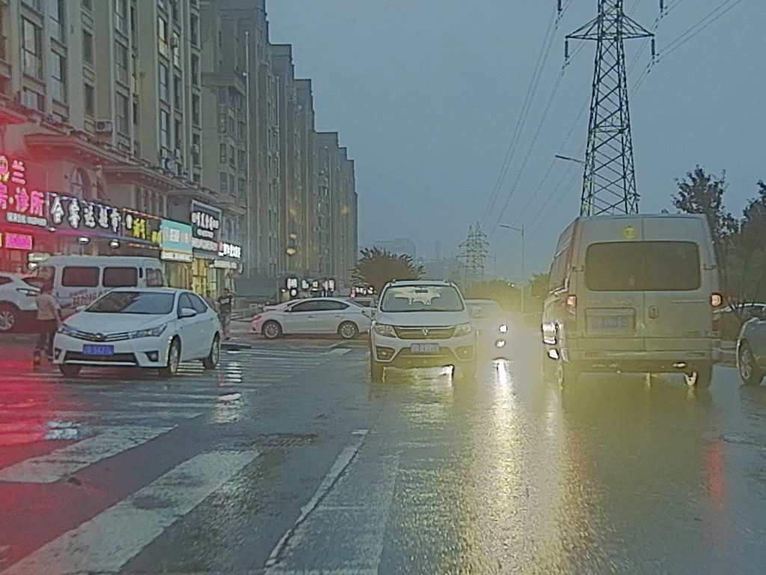
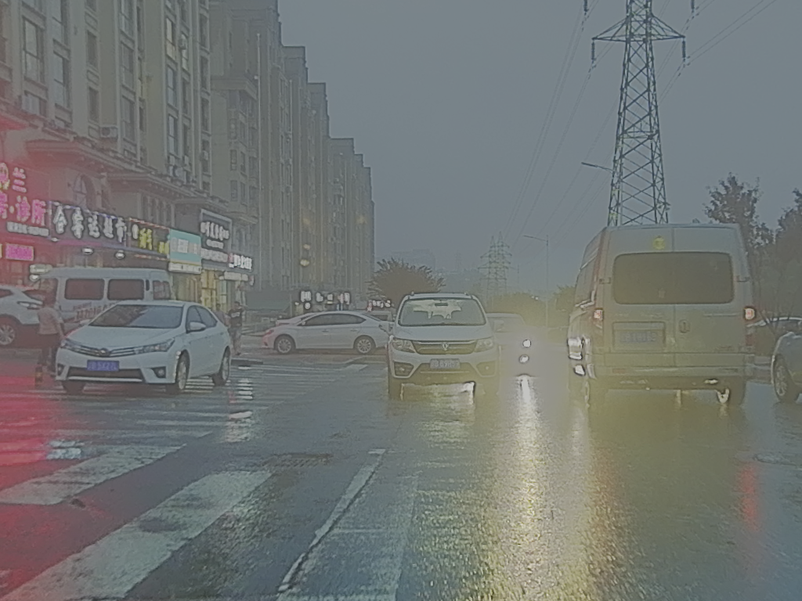
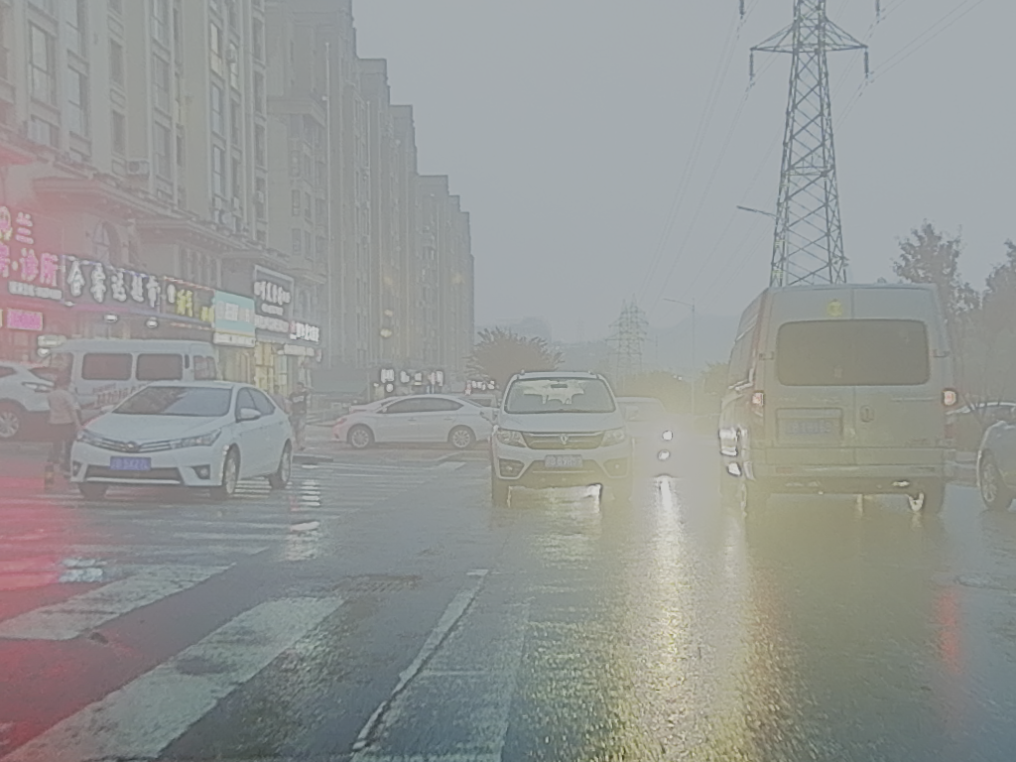
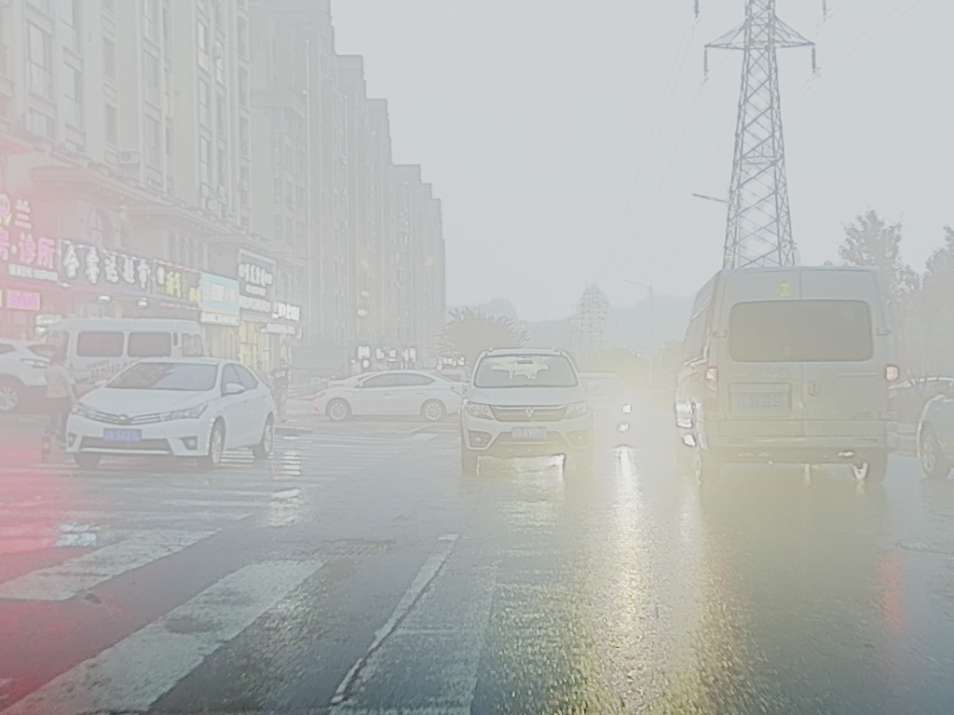

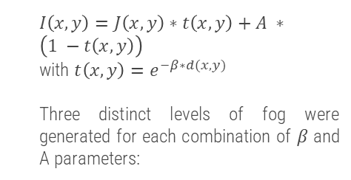
Dataset
To create a synthetic dataset, the Atmospheric Scattering Model will be applied to the M3FD dataset, which consists of 4200 images.
$I\left(x,y\right)=J\left(x,y\right)∗t\left(x,y\right)+A ∗\left(1 −t\left(x,y\right)\right)$
with $t\left(x,y\right)=e^{−β∗d(x,y)}$
Three distinct levels of fog were generated for each combination of 𝛽 and A parameters:
A=[120,180,220] $β$ = [0.004, 0.006, 0.008]

Slide 9
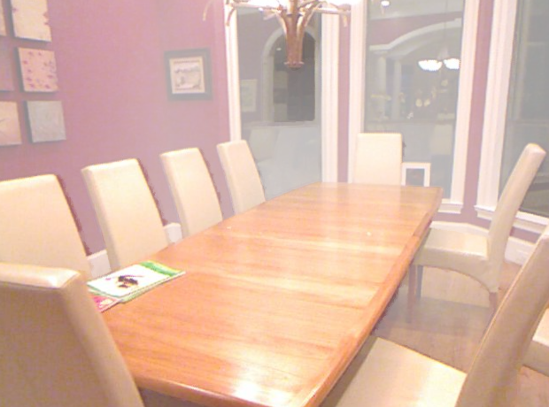
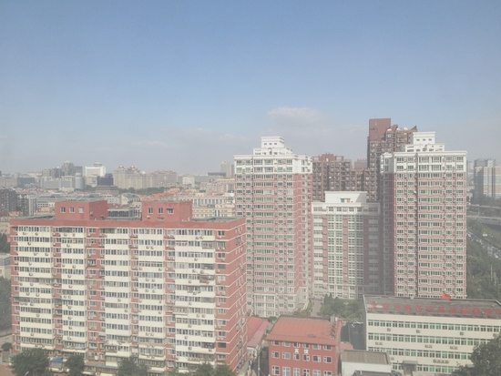
Dataset
RESIDE is a comprehensive benchmark that integrates both synthetic and real hazy images, designed for the evaluation of dehazing algorithms. It consists of 500 hazy images from indoor and outdoor scenarios, along with their corresponding ground truth images without haze.

Slide 10
04
Models

Slide 11
Models
Pix2pixHD GAN trained on the G1 part of the network to remove 3 different levels of haze from images.
Pix2pixHD GAN trained on both the G1 and G2 parts of the network to remove 3 different levels of haze from images.
A classifier based on VGG or InceptionV3 is employed to categorize haze into four levels of intensity: high, medium, low or no haze.
Three specialized Pix2PixHD GANs, one for each level of haze, are employed after the classifier to perform haze removal.

Slide 12
05
Evaluations

Slide 13
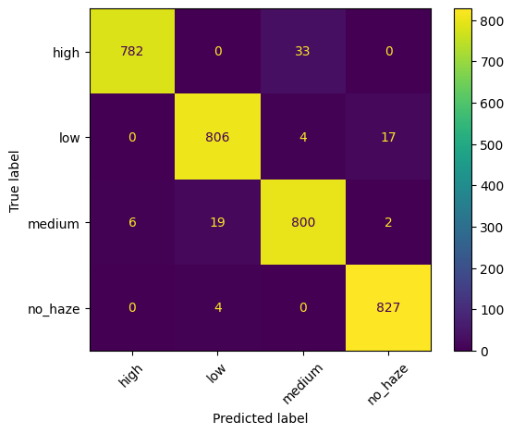

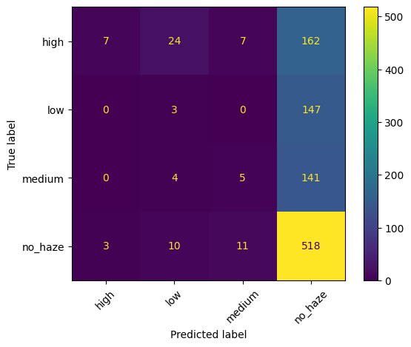
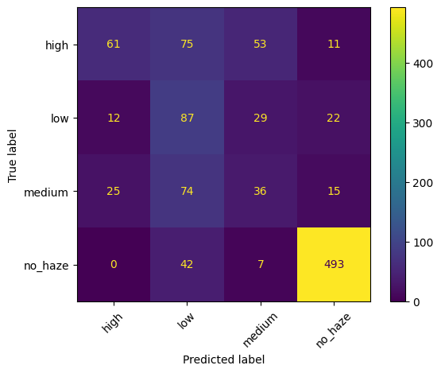
Classifier Comparison
VGG16
INCEPTIONV3
M3FD
SOTS RESIDE

Slide 14
Model Comparison Indoor
 | MSE | SSIM | PSNR | PIQE | NIQE
GENERAL MODEL | 104.7894 | 0.7211 | 15.9983 | 27.8453 | 15.5920
CLASSIFIER + 3GAN | 106.4946 | 0.7053 | 15.3621 | 33.5978 | 14.9868
Underlining the most significant positive outcomes

Slide 15
Model Comparison Outdoor
 | MSE | SSIM | PSNR | PIQE | NIQE
GENERAL MODEL | 104.7441 | 0.7536 | 17.2679 | 14.4238 | 14.8355
CLASSIFIER + 3GAN | 102.7947 | 0.7613 | 16.5595 | 10.6168 | 13.0812
Underlining the most significant positive outcomes

Slide 16
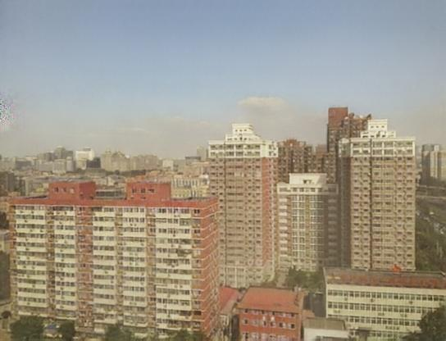

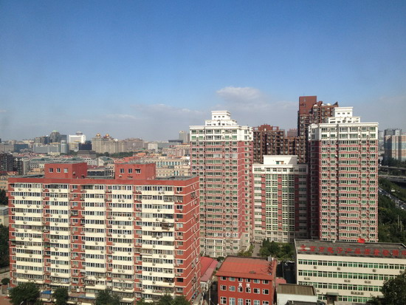
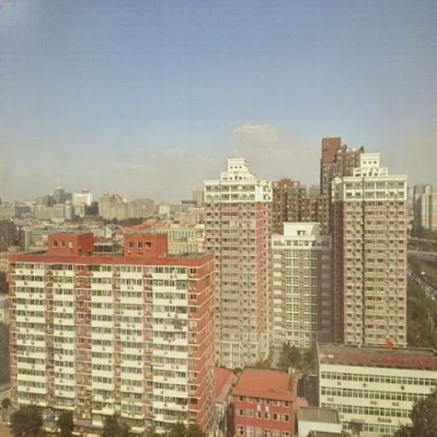
Qualitative Evaluation
Syntethized with General GAN Model
Input image with Haze
Original image
Syntethized with Specialized GAN Model

Slide 17
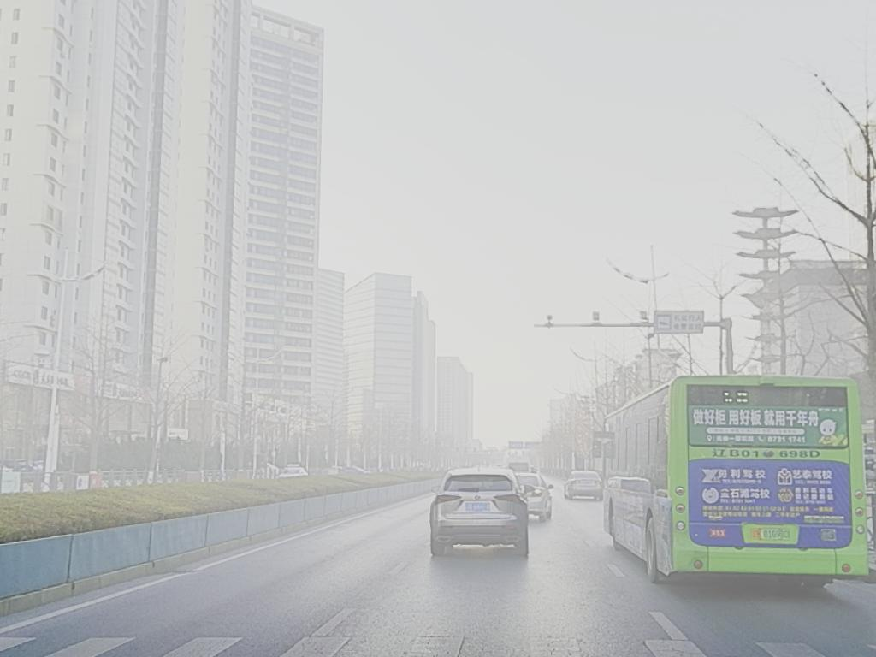
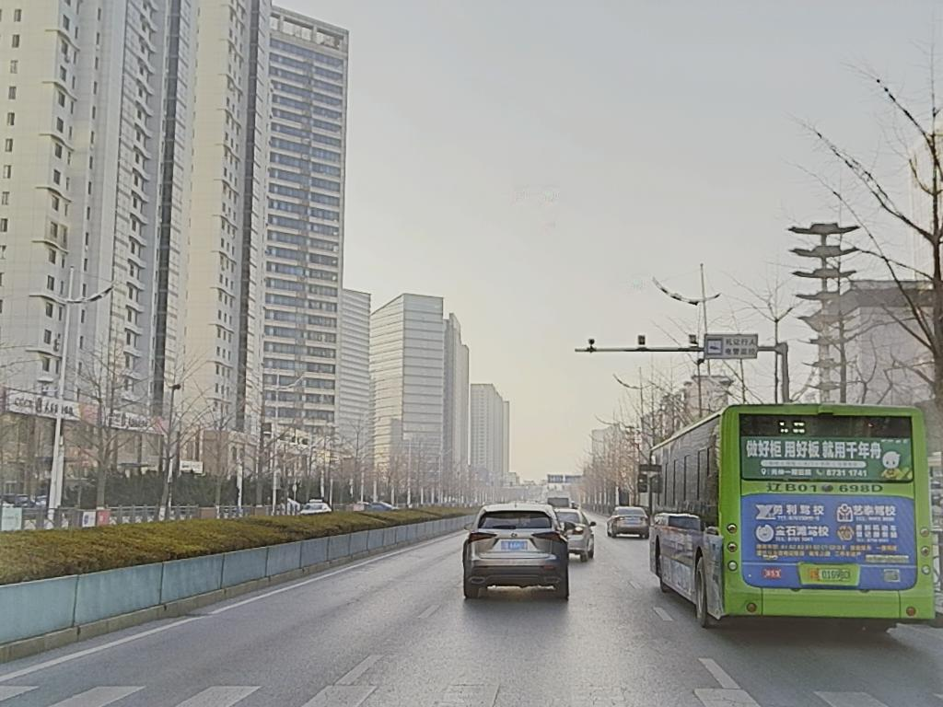
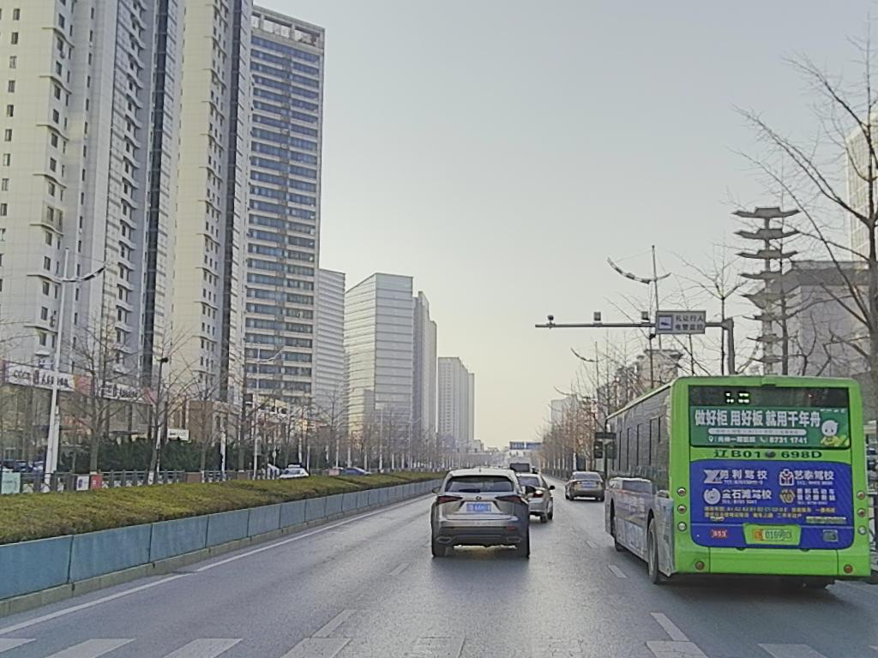
Model G1 & G2
Input
Synthetized
Original

Slide 18
06
Conclusions

Slide 19
Conclusions
Comparing metrics for indoor and outdoor images about RESIDE SOTS dataset, we found that they were not adequately satisfying.
We had limitations about HW that limited us to train models only until 50th epoch. Moreover, we had to reduce image size loosing information.
Results obtained with the classifiers were not good, we need a new training phase to enhance the performance, but we had not other computational resources.

Slide 20

THANKS
mattia.didonato95@gmail.com
matteogiorgi404@gmail.com
https://github.com/mattiadido95/Haze-Fog-suppression

